Slide 1
Teaching Artist Cohort Program
Virtual Presentation

Slide 2
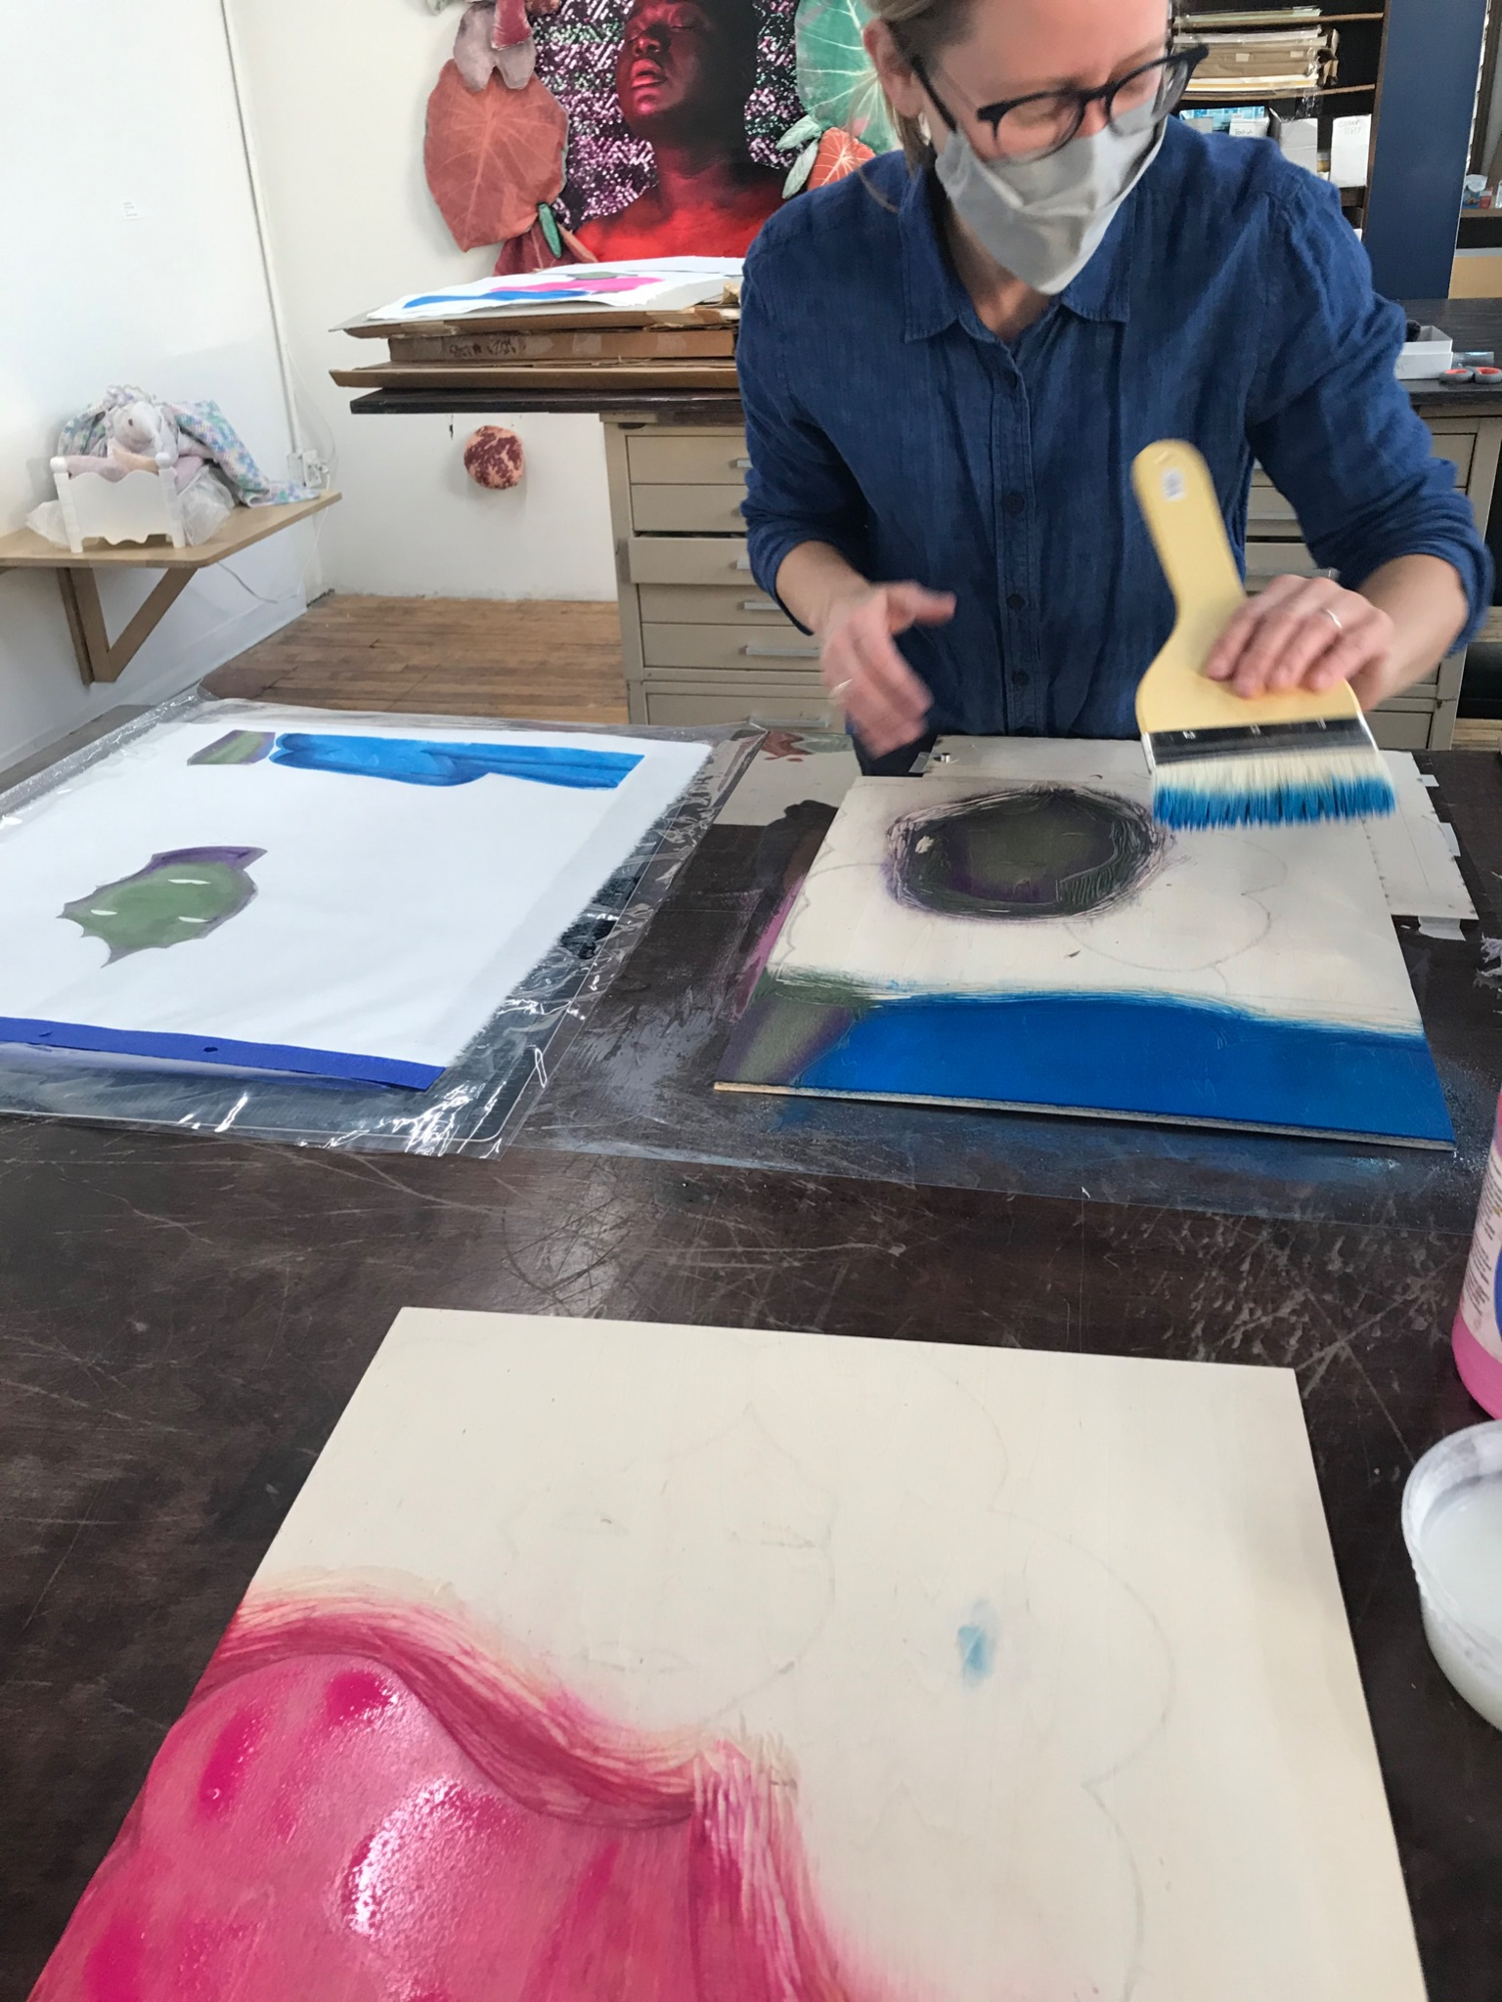
Presentation Outline
Important Dates
Why a Cohort?
Eligibility & Expectations
Covid-19 Policies
Compensation & Benefits
Overview of Educational Programs
Scheduling & Training Logistics
Selection Process
Questions

Slide 3
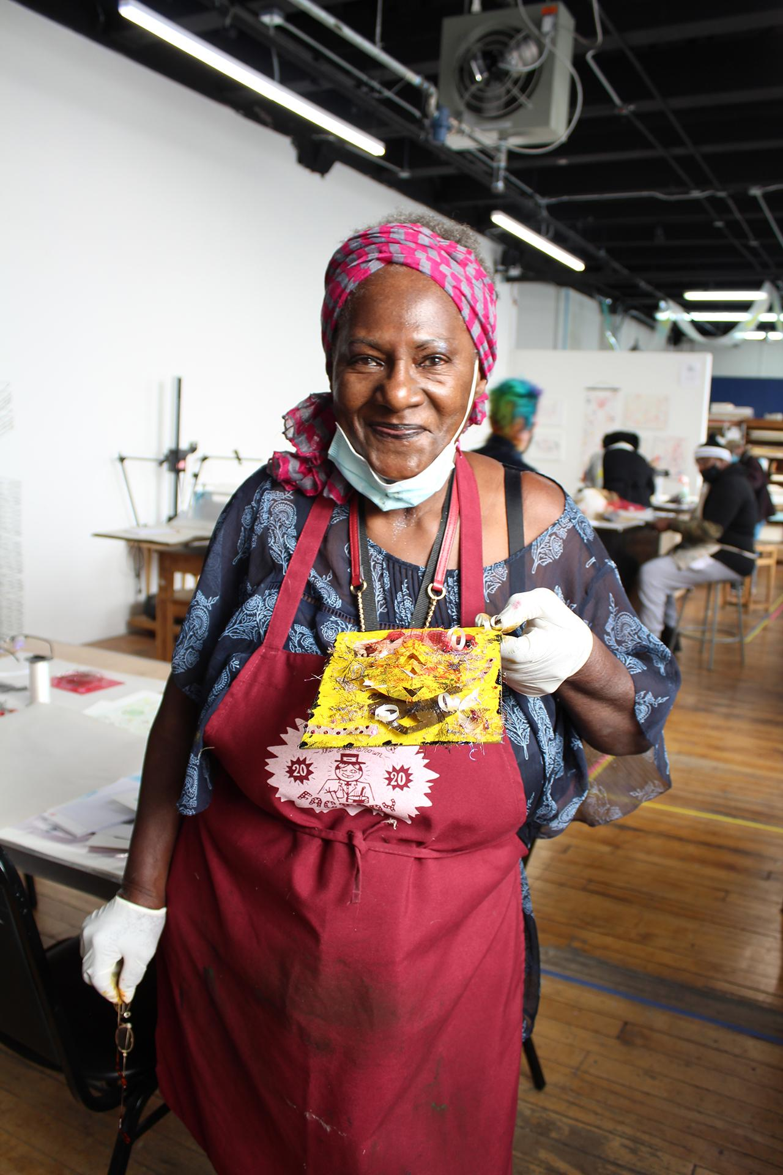
Important Dates
Aug 1, 2022 Deadline to Apply Aug 22, 2022 Notification of Acceptance Aug 29, 2022 Welcome Session Individual Planning Sessions 8/29 - 9/23/22 Onboarding (about 20 hours) Aug 26, 2022 Teaching Period Begins May 26, 2023 Inaugural cohort ends

Slide 4
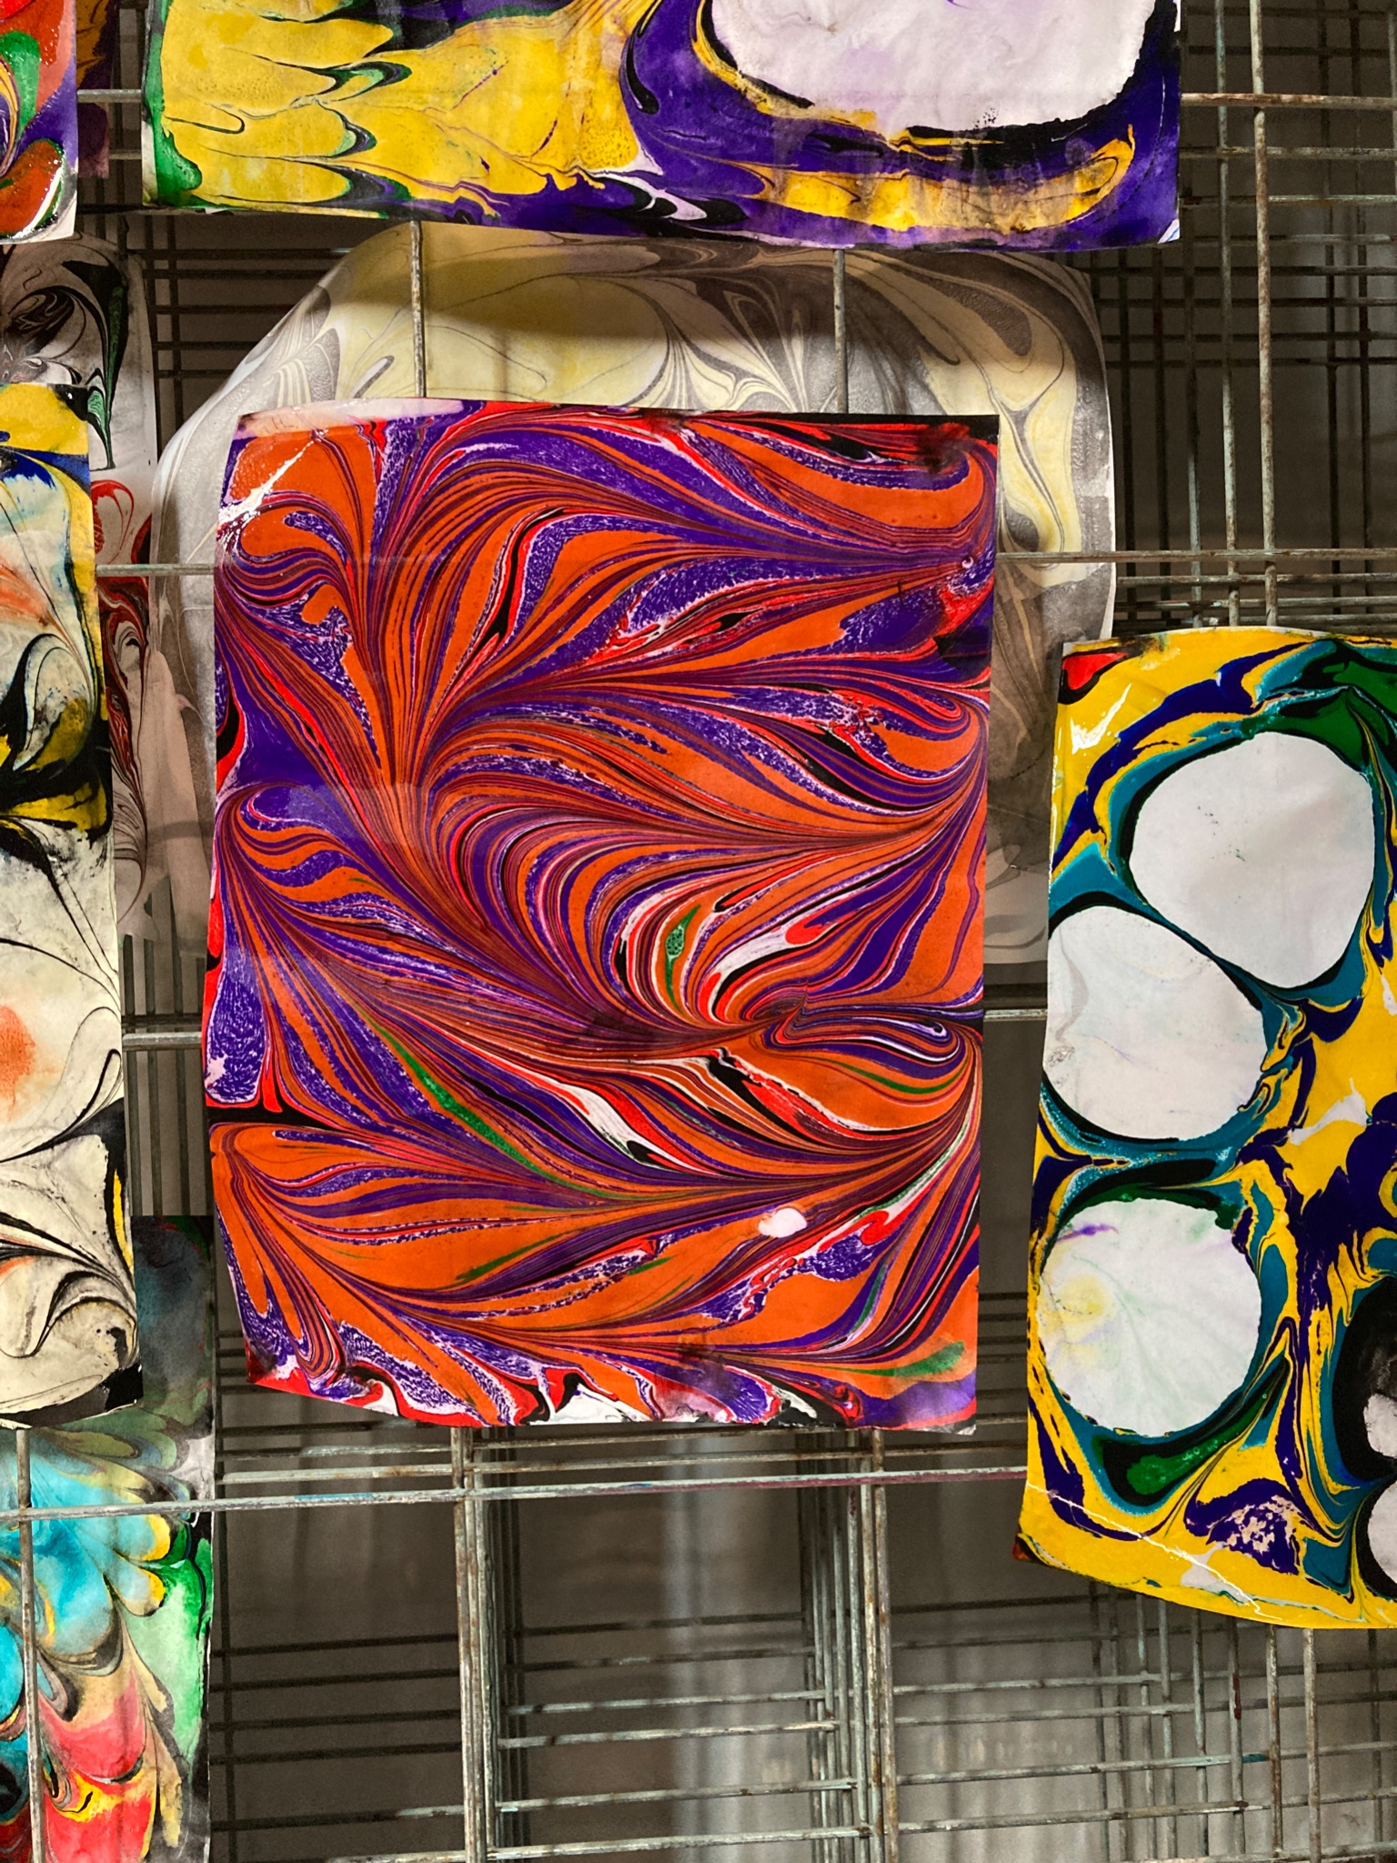
Why a Teaching Cohort?
To provide substantial and reliable arts-related income to working artists.
To provide continuity and balanced, inspiring curriculum for our students.
Increase comradery and peer-to-peer support within our Teaching Artist community.
To support the growth of educational opportunities for youth & family programs.

Slide 5
Eligibility
Artists whose current artistic practice utilizes printmaking
Artists with enough printmaking experience to work independently in multiple areas of the studio
Artists who demonstrate an ongoing commitment to community arts education
Artists who are local to the Chicago area with reliable transportation to and from Spudnik Press Cooperative
Artists that have experience developing and leading class curriculum

Slide 6
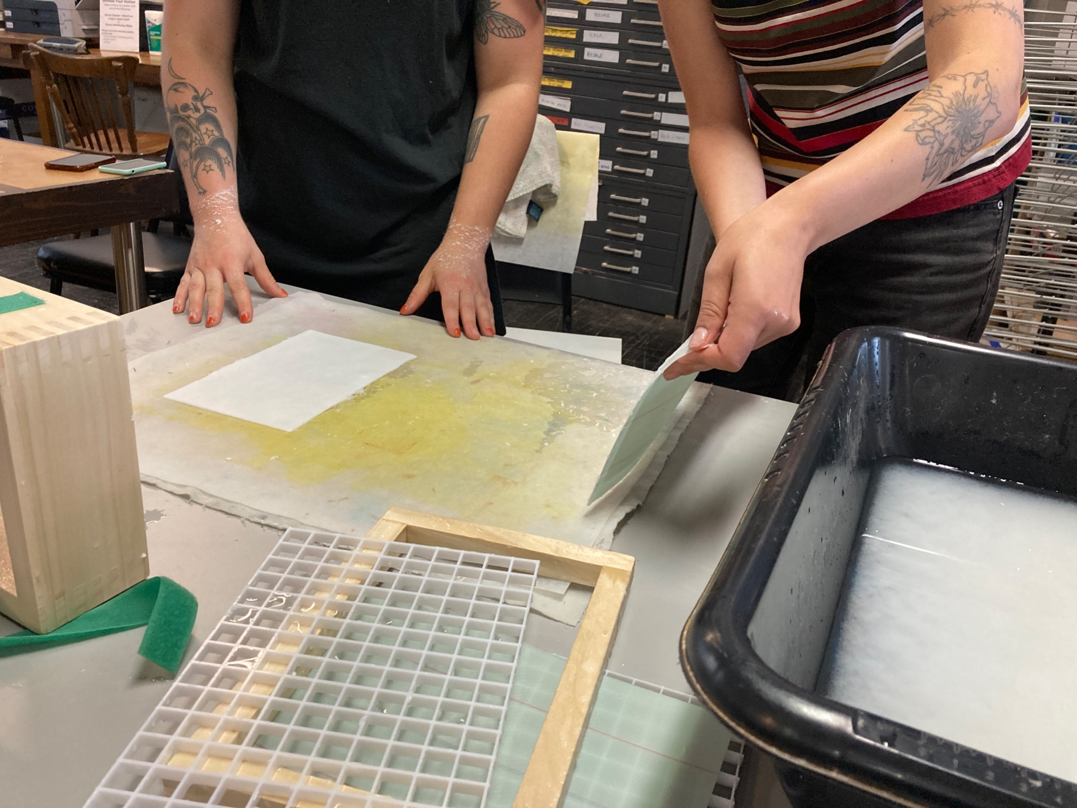
Eligibility
We understand that teaching experience comes in many forms, both formal and informal, and we welcome applicants with diverse teaching backgrounds.
Spudnik Press Cooperative encourages applications from artists of all backgrounds regardless of race, color, gender or religious affiliation, including but not limited to: BIPOC artists, LGBTQ artists, women artists, artists with disabilities, and artists of veteran status.

Slide 7
Basic Expectations
Commit to the full 10 month duration of this program (Aug 2022 through May 2023)
Complete authorization to Spudnik Press equipment, facilities, and procedures during their first month in the program
Once onboarded, lead approximately two educational opportunities per week (about 5.5 hours) through a combination of group classes and private lessons
Attend seasonal planning sessions with fellow teaching artists
Develop teaching proposals with support from Spudnik staff

Slide 8
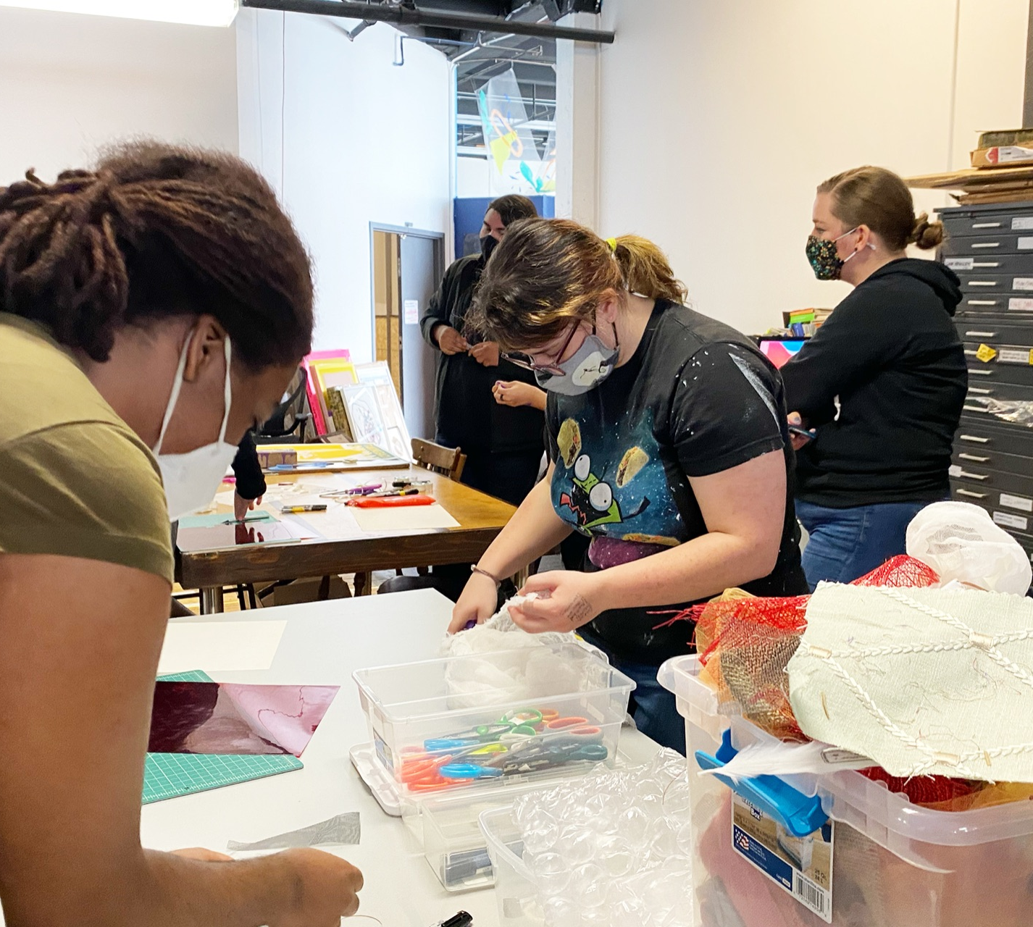
Covid-19 Policy
Teaching artists are required to abide by all public policies related to Covid-19, including the requirement of providing proof of vaccination.
We do have protocol in place for medical and religious exemptions. However, everyone teaching in person must be vaccinated.

Slide 9
Covid-19 Policy
Teaching Artists are required, as needed, to affirm proof of vaccination for their students as they arrive on site for their first class session.
All private groups are required to sign an agreement that they meet or exceed CDC guidelines for the age group that they work with.
All requests for exemptions must be handled by staff. Teaching Artists are not expected to determine if an extension should be granted.

Slide 10
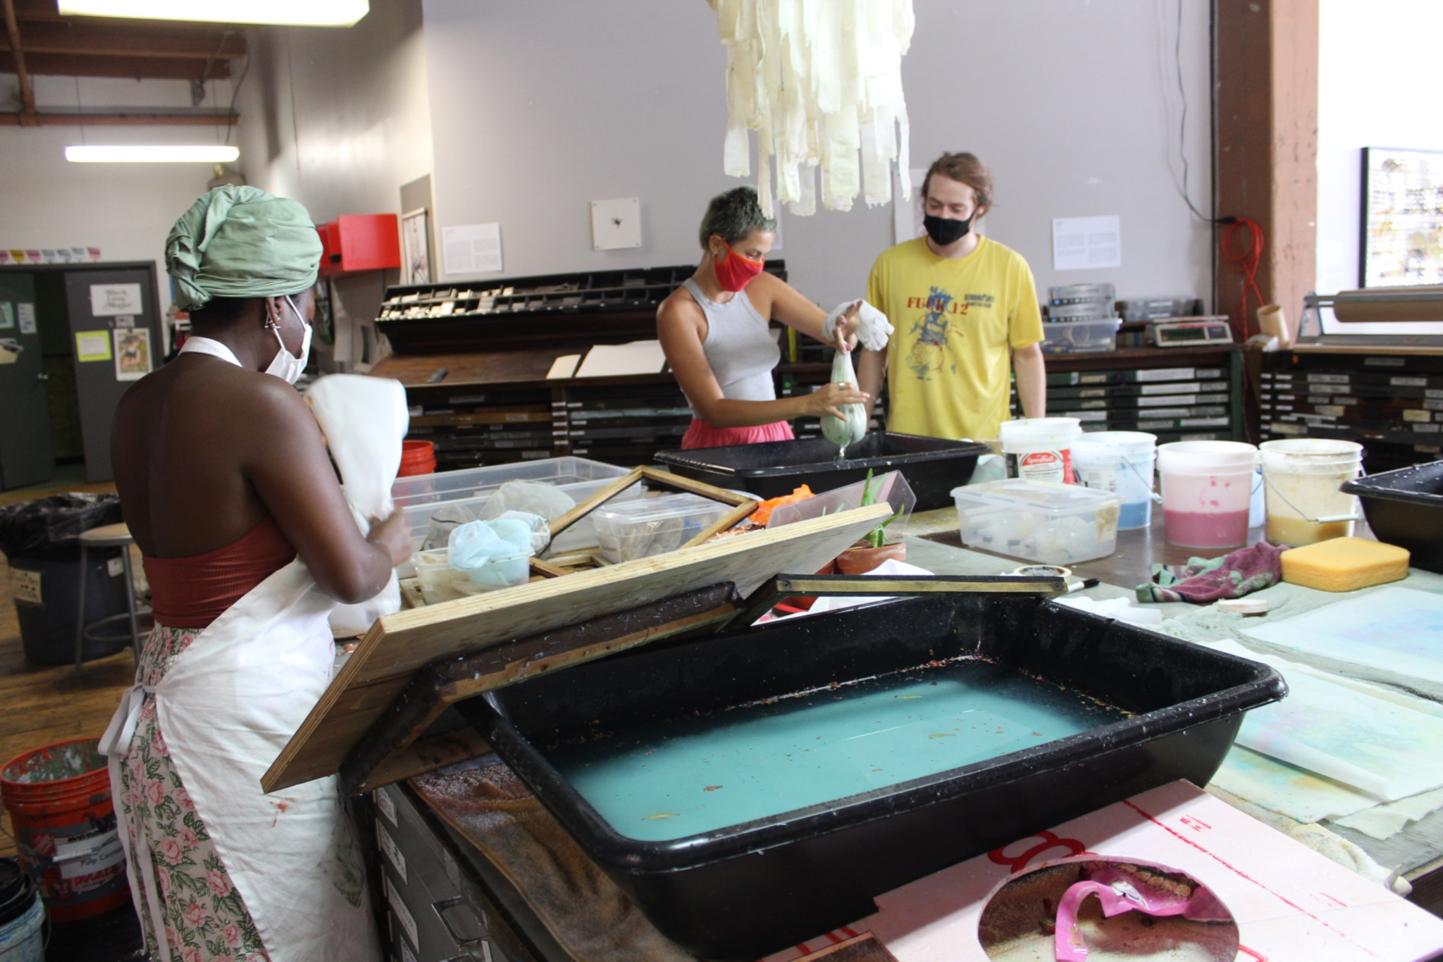
Compensation & Benefits
Keyholder Access
Studio Access Trainings
Annual Membership
Free Spudnik Classes
Professional development opportunities, TBD
Monthly stipend

Slide 11
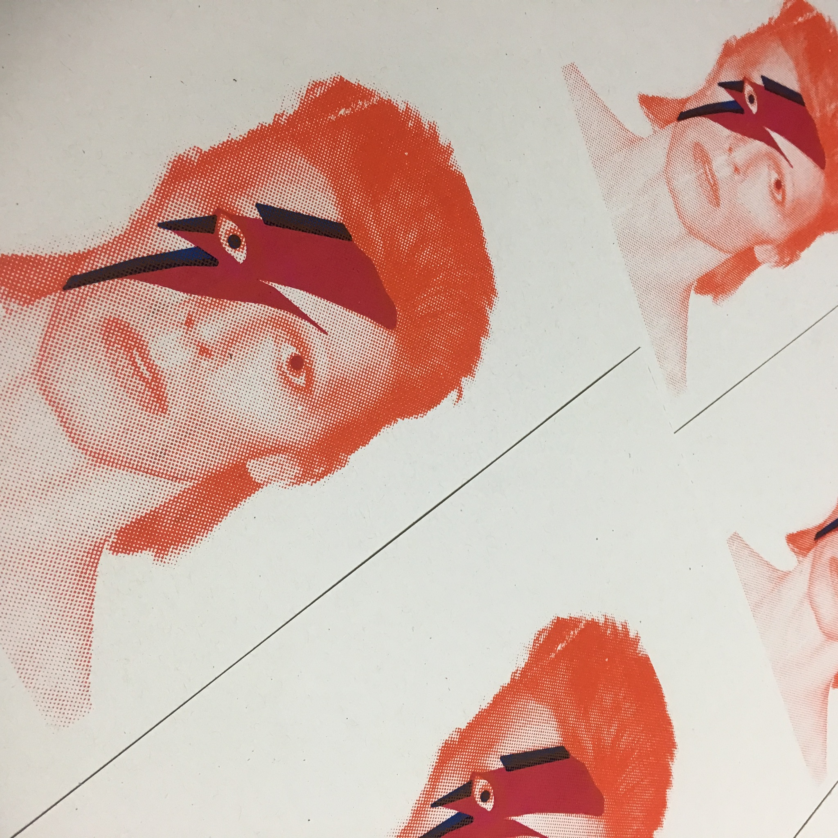
Stipend Details
A $500 monthly stipend is based on maintaining a rolling average of 22 to 24 hours of teaching per month based on teaching twice per week (or 5.5 hours).
However, a reasonable amount of variation is expected week-to-week and month-to-month.

Slide 12
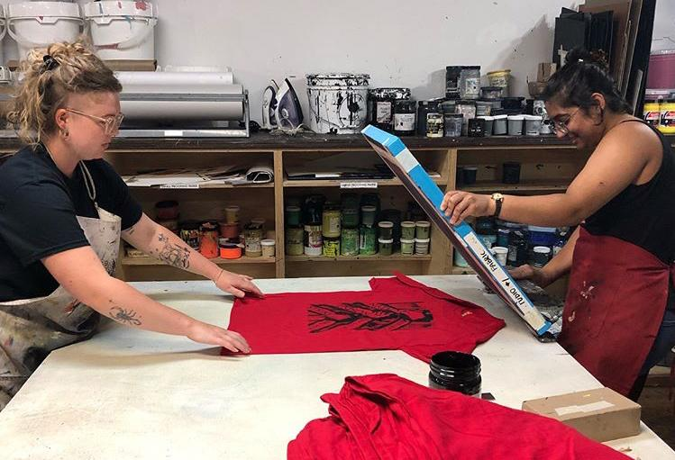
Stipend Details
What if I teach more than 24 hours a month?
Teaching artist exceeding 24 hours in any given month will receive a $500 stipend plus an additional $22 per teaching hour exceeding 24.

Slide 13
Stipend Details
What if I teach less than 22 hours a month?
If an artist has a 3-month rolling average of less than 22 hours/month, they will be paid at an hourly rate of $22/hour instead of the flat stipend.
This allows scheduling flexibility for both the artist & Spudnik Press.
This guarantees $500 for the first 3 months of the program.

Slide 14
Stipend Scenarios
32 hours in a month | 18 hours in a month | 18 hours in a month
Exceeds standard range | Rolling average is more than 22 | Rolling average is less than 22
$500 + 8 hours @ $22 = $676 stipend | $500 stipend | 18 hours @ $22 = $396 stipend

Slide 15
Who all teaches at Spudnik?
Cohort Teaching Artists New in 2022; Expected to teach about 70% of all educational offerings.
Independent Teaching Artists Artists who taught with Spudnik prior to 2022 are invited to continue teaching.
Cohort Alumni Graduates from the cohort-program can continue teaching in a lighter or more focused capacity
Guest Educators Outside educators will be brought in from time-to-time to lead special topic workshops or community projects developed in collaboration with outside partners.
Staff Current leads all Studio Access Trainings and other educational programs as needed.

Slide 16
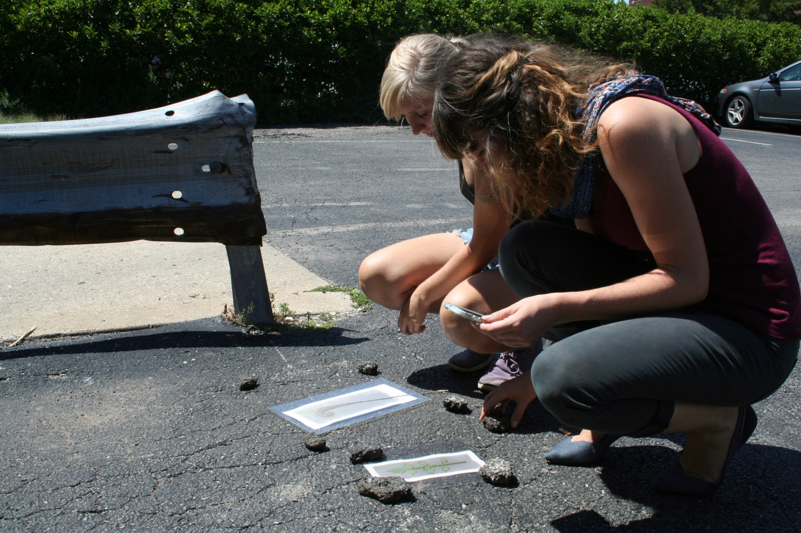
Educational Categories
Public Enrollment-Based Opportunities
Core Classes
Special Topics: Proposals Invitational
Private Lessons

Slide 17
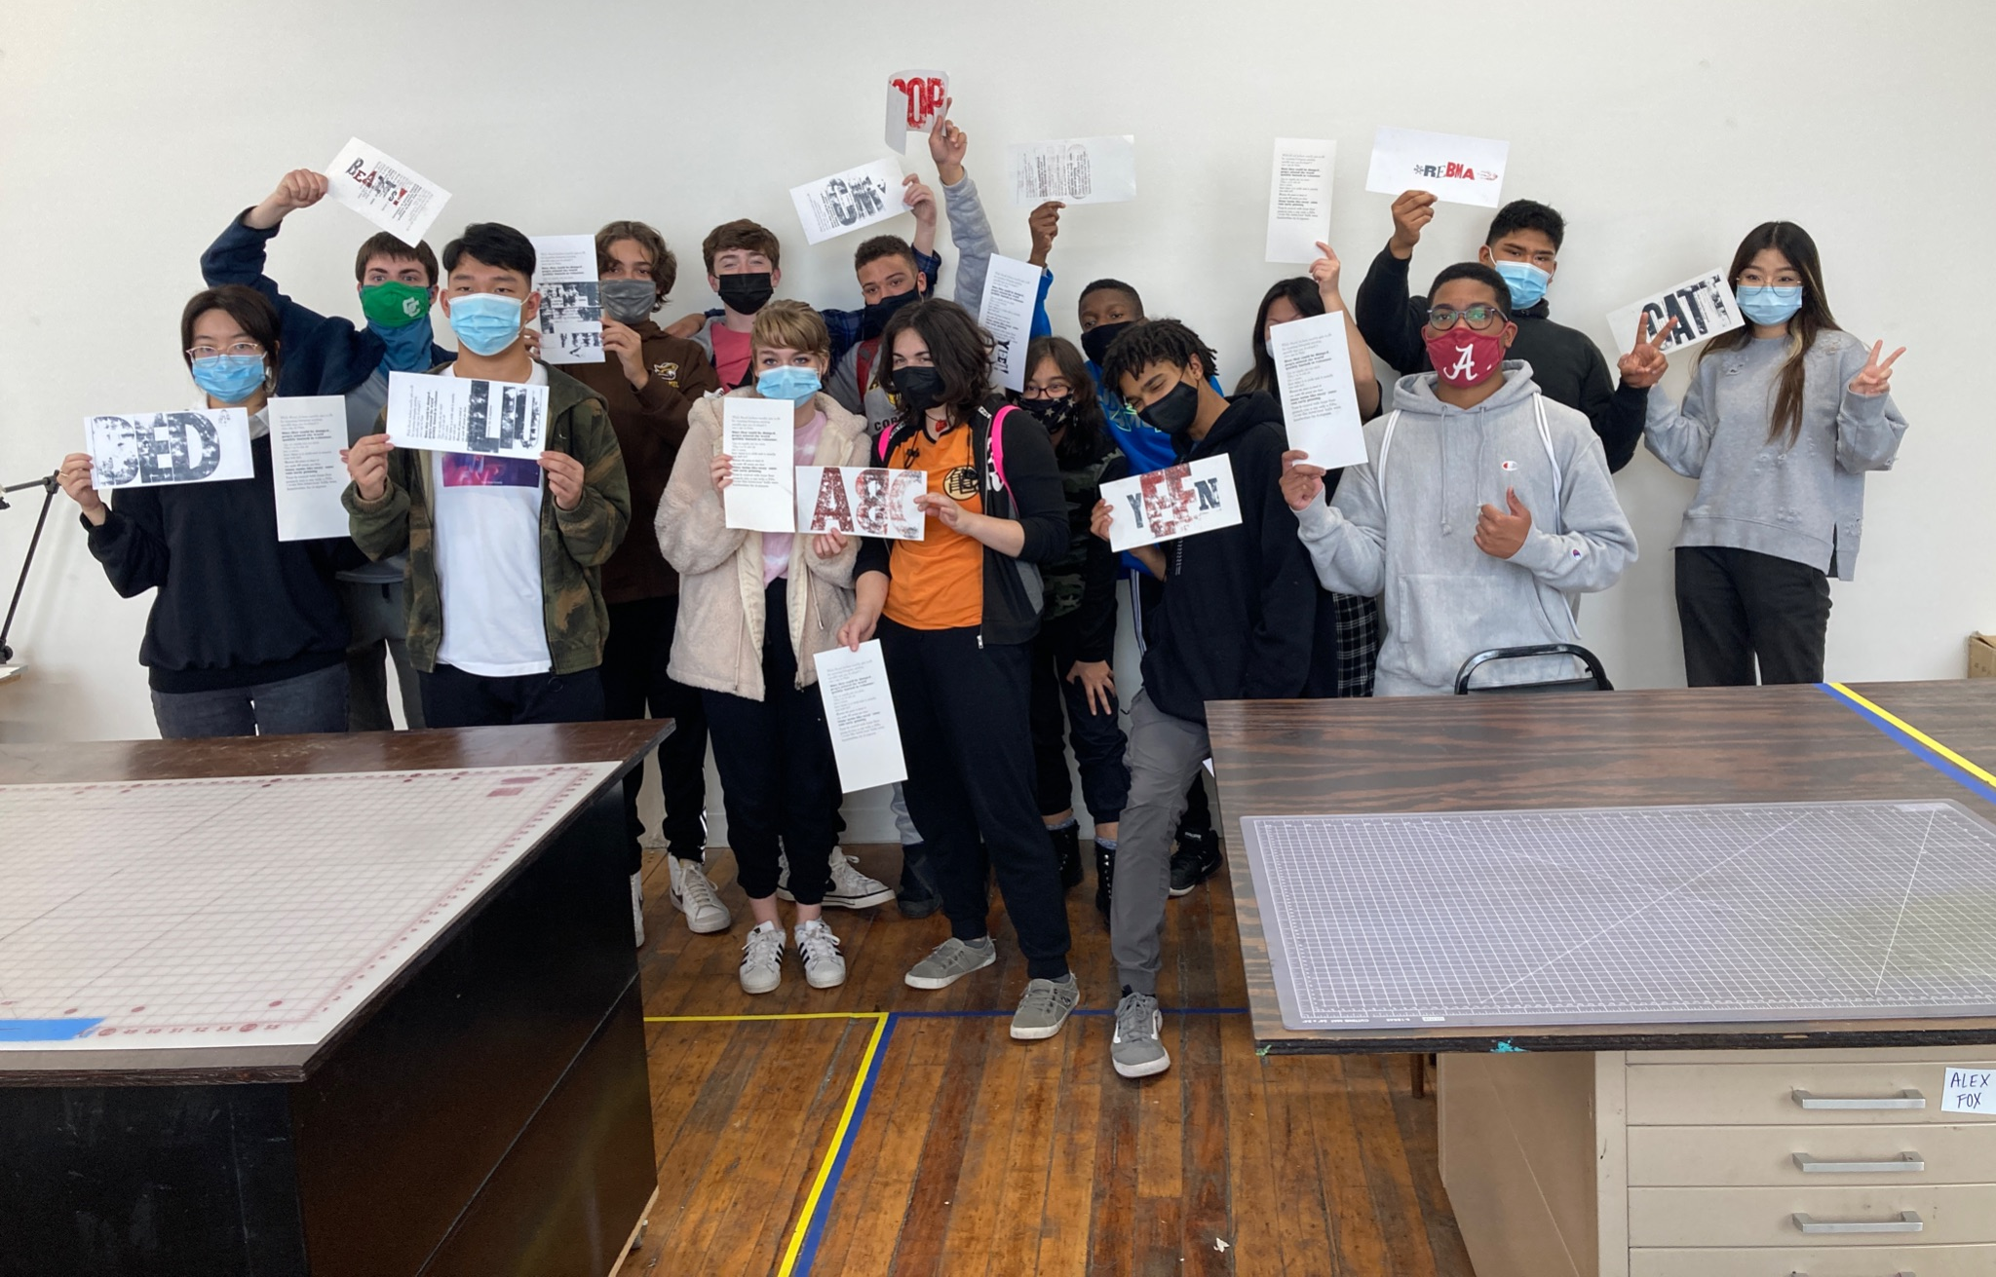
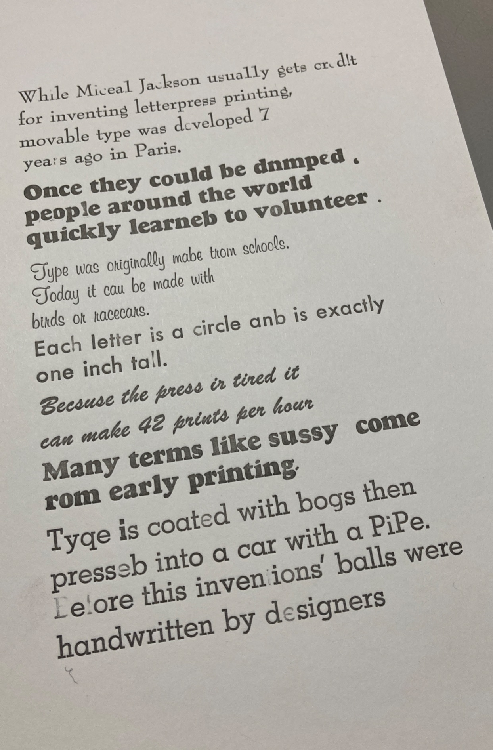
Educational Categories
Private / Partnership-Based Opportunities:

Slide 18
Educational Categories
Private / Partnership-Based Opportunities:
Youth Workshops Peer nonprofits, colleges & universities, occasional birthday parties Tend to be private / not open to the public
Adult Workshops Private businesses, peer nonprofits Tend to be private / not open to the public
Youth & Family Tend to be invited by peer non-profits / Tend to be open to the public In 2022: Goal of growing youth & family programs and initiating more ongoing partnerships

Slide 19
Scheduling
Typically Tuesday & Wednesday evenings & Sundays
Occasionally week days on during Open Studio sessions
Blend of core offerings & artist-proposed special topics
Typically scheduled 8-10 weeks in advance
Public Group Classes
Offered in 3-hour sessions
Students encourage to sign up for 4-6 sessions culminating in Studio Authorization
Each teacher sets own availability within our scheduling software
Students can see availability online and sign up autonomously
Private Lessons
Coordinated by staff who then invites a teaching artist to lead the session
Staff creates base lesson plan and invites teaching artist to adapt as needed
Typically scheduled 2-4 weeks in advance
Private Workshops

Slide 20
What training is provided?
Prior to independently leading classes, Teaching Artists will complete the following:
Welcome Session (1.5 hours)
Individual Planning Session (1.5 hours)
Teaching Artist Policies & Procedures Overview (1.5 hours)
Studio Orientation & Authorization (about 4 hours)
Group Proposal Development Workshop (2 hours)
Peer Skill Share Session (2 hours)
Acuity Training (1.5 hours)
Class Observations and/or Teaching Assistance (about 8 hours)

Slide 21
How Do I apply?
Artists will apply through our online application form which requires:
Letter of interest addressing:
Why you are interested in this program
Personal teaching goals, learning goals for students, and/or teaching philosophy
A portfolio of 7-10 images:
Work should be from the last two years and include print-based work
Image List:
For each work, include the file name, title, medium, year of completion, and dimensions.
Brief Artist Bio (Please limit to 100 words or less)
Current Resume or CV
1-3 References with contact information and their relationship to you.

Slide 22
Selection Process
Applications are reviewed by a panel including staff and a board member. Staff will conduct in-person or virtual interviews with finalists.
Decisions are based on:
Clarity of the proposal
Extent of prior teaching experience
Ability of portfolio to convey technical expertise of printmaking processes
Ability of portfolio to convey clear intentions or conceptual ideas
Alignment of skills, learning goals for students, and/or teaching philosophy with our educational needs and priorities
Ability of Spudnik to support personal teaching goals
Scheduling logistics

Slide 23
Questions?
Additional questions can be sent to: sara@spudnikpress.org Deadline to Apply: Thursday, August 1, 2022

